Slide 1
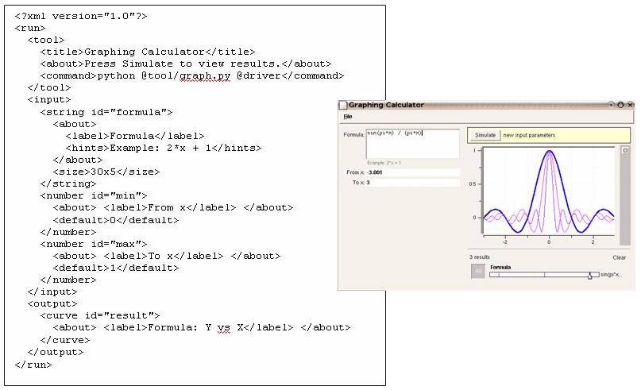
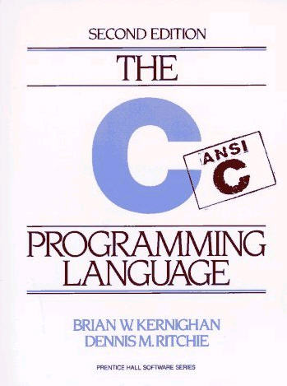
Rappture with C
Derrick Kearney
HUBzero® Platform for Scientific Collaboration
Purdue University
Original slides by Michael McLennan
This work licensed under
Creative Commons
See license online:
by-nc-sa/3.0

Slide 2
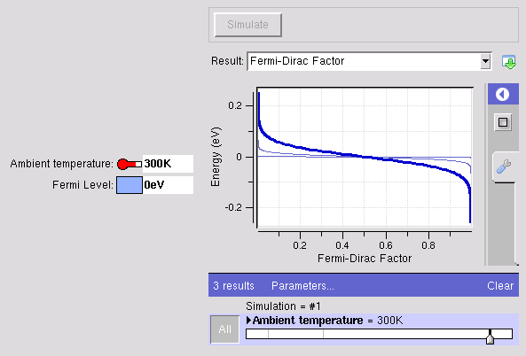
Example: app-fermi in C
The usual way…
The Rappture way…
% gcc fermi.c -o fermi -lm
% ./fermi
Enter the Fermi level (eV):
Ef = 2.4
Enter the temperature (K):
T = 77
% more out.dat
FERMI-DIRAC FUNCTION F1/2
f1/2 Energy (eV)
------------ ------------
0.999955 2.33365
0.99995 2.33431
0.999944 2.33498
https://nanohub.org/infrastructure/rappture
source code: rappture/examples/app-fermi

Slide 3
What is the interface?
fermi.c
#include <stdio.h>
#include <math.h>
int main(int argc, char *argv[]) {
double T, Ef, E, dE, kT, Emin, Emax, f;
printf("Enter Fermi energy in eV:\n");
scanf("%lg", &Ef);
printf("Enter the Temperature in K:\n");
scanf("%lg", &T);
kT = 8.61734e-5 * T;
Emin = Ef - 10*kT;
Emax = Ef + 10*kT;
E = Emin;
dE = 0.005*(Emax-Emin);
while (E < Emax) {
f = 1.0/(1.0 + exp((E - Ef)/kT));
printf("%f %f\n",f, E);
E = E + dE;
}
return 0;
}
Inputs/outputs are
identical to the
MATLAB version
number
number
physics
curve

Slide 4
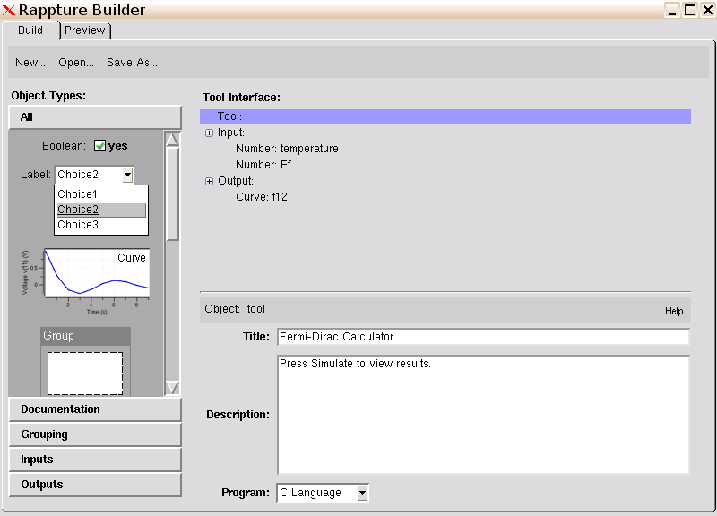
Same interface - Use C Language
Change this

Slide 5
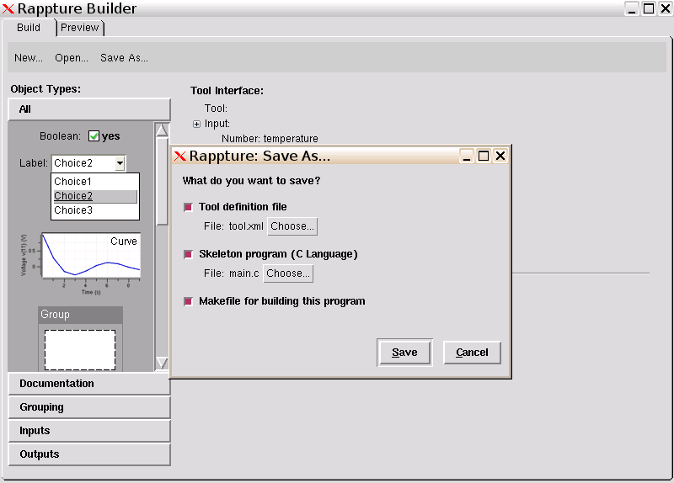
Generate program and Makefile
Save these

Slide 6
Add physics to the generated code
Generated program: main.c
…
/* get input value for input.number(temperature) and convert to K */
rpGetString(io,"input.number(temperature).current", &data);
temperature = rpConvertDbl(data, "K", &err);
/* get input value for input.number(Ef) and convert to eV */
rpGetString(io,"input.number(Ef).current", &data);
Ef = rpConvertDbl(data, "eV", &err);
/*
*********************************************************
* Add your code here for the main body of your program
*********************************************************
*/
/* save output value for output.curve(f12) */
/* this shows just one (x,y) point -- modify as needed */
sprintf(line, "%g %g\n", x, y);
rpPutString(io,"output.curve(f12).component.xy", line, RPLIB_APPEND);
rpResult(io);
exit(0);
}
…
/* get input value for input.number(temperature) and convert to K */
rpGetString(io,"input.number(temperature).current", &data);
temperature = rpConvertDbl(data, "K", &err);
/* get input value for input.number(Ef) and convert to eV */
rpGetString(io,"input.number(Ef).current", &data);
Ef = rpConvertDbl(data,
/*
************************
* Add your code here fo
************************
*/
/* save output value for
/* this shows just one (x,
sprintf(line, "%g %g\n", x, y);
rpPutString(io,"output.curve(f12).component.xy", line, RPLIB_APPEND);
rpResult(io);
exit(0);
}
kT = 8.61734e-5 * T;
Emin = Ef - 10*kT;
Emax = Ef + 10*kT;
E = Emin;
dE = 0.005*(Emax-Emin);
while (E < Emax) {
f = 1.0/(1.0 + exp((E - Ef)/kT));
E = E + dE;
}
physics

Slide 7
Add physics to the generated code
Generated program: main.c
…
/* get input value for input.number(temperature) and convert to K */
rpGetString(io,"input.number(temperature).current", &data);
temperature = rpConvertDbl(data, "K", &err);
/* get input value for input.number(Ef) and convert to eV */
rpGetString(io,"input.number(Ef).current", &data);
Ef = rpConvertDbl(data, "eV", &err);
kT = 8.61734e-5 * temperature;
Emin = Ef - 10*kT;
Emax = Ef + 10*kT;
E = Emin;
dE = 0.005*(Emax-Emin);
while (E < Emax) {
f = 1.0/(1.0 + exp((E - Ef)/kT));
/* save output value for output.curve(f12) */
sprintf(line, "%g %g\n", f, E);
rpPutString(io,"output.curve(f12).component.xy", line,
RPLIB_APPEND);
E = E + dE;
}
rpResult(io);
exit(0);
}

Slide 8
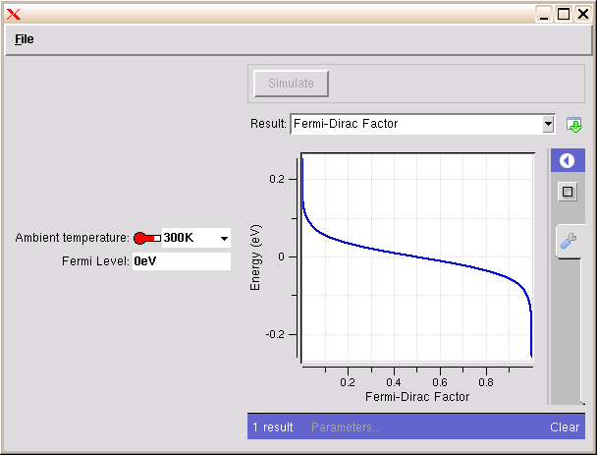
Build the program
Don’t forget to “make” the program!
% make
gcc -g -Wall -I${RAPPTURE_PATH}/include main.c -o mainc -L${RAPPTURE_PATH}/lib -lrappture -lm
% ls
Makefile tool.xml main.c mainc
% rappture

Slide 9


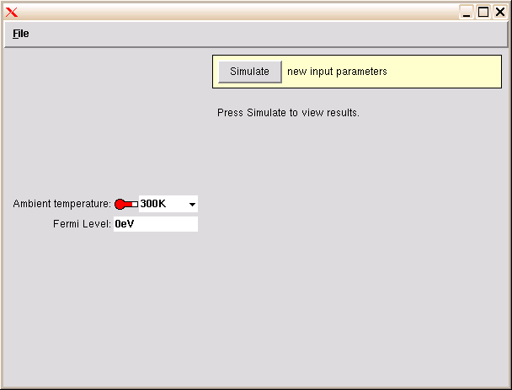
Running the code
Builder
Runner
<XML>
driver1827.xml
kT = 8.61734e-5 * T;
Emin = Ef - 10*kT;
Emax = Ef + 10*kT;
E = Emin;
dE = 0.005*(Emax-Emin);
while (E < Emax) {
f = 1.0/(1.0 + exp((E - Ef)/kT));
E = E + dE;
}
physics
<?xml version="1.0"?>
<run>
…
<output>
<curve id="f12">
…
<component>
<xy>
0.999955 2.33365
0.99995 2.33431
0.999944 2.33498
…
</output>
</run>
<XML>
<XML>
tool.xml
run12703129102.xml

Slide 10

How your program gets invoked
<?xml version="1.0"?>
<run>
<tool>
<about>Press Simulate to view results.</about>
<command>@tool/mainc @driver</command>
</tool>
<input>
…
<XML>
tool.xml
/apps/yourtool/current/mainc driver327.xml
int main(int argc, char * argv[]) {
…
/* open the XML file */
io = rpLibrary(argv[1]);
…
rpGetString(io,"input.number(temperature).current", &data);
temperature = rpConvertDbl(data, "K", &err);
…
Rappture
rpPutString(io,"output.curve(f12).component.xy", line, RPLIB_APPEND);
rpResult(io);
exit(0);
}

Slide 11

Not Much Overhead
It’s easy to add Rappture to your new tools:
Instead of this…
Do this…
<number id="Ef">
<about>
<label>Fermi Level</label>
</about>
<units>eV</units>
<default>0eV</default>
</number>
Documentation
scanf("%lg",&Ef);
rpGetString(lib, path, &data);
Ef = rpConvertDbl(data, “eV", &err);
rpPutString(lib, path, val, RPLIB_APPEND);
…
rpResult(lib);
printf(“%g”,Ef);

Slide 12
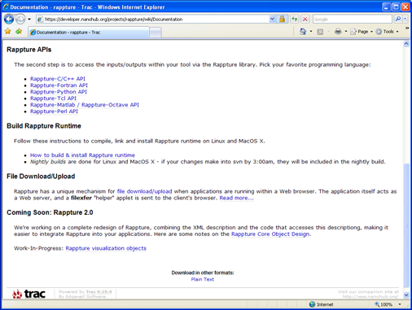
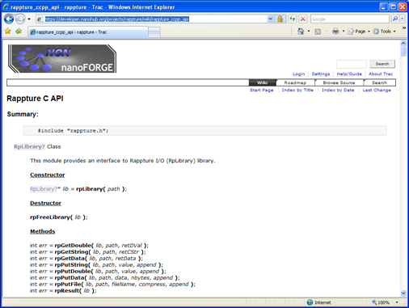
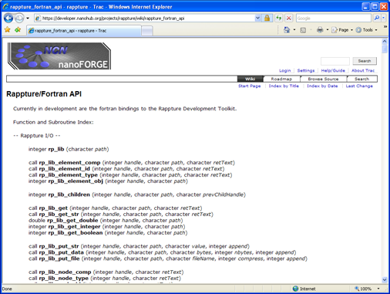
Reference Documentation
http://rappture.org
Documentation
Rappture-C/C++ API
Example:
app-fermi in C

